Slide 1
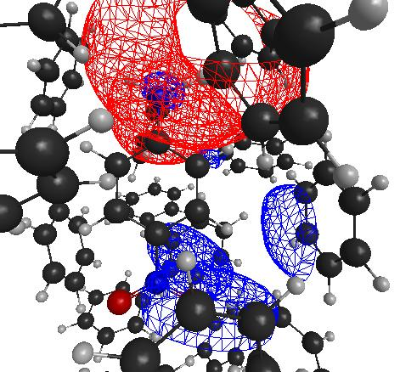
Excited state dynamics with the Effective Fragment Potential method?
Lyudmila V. Slipchenko
Department of Chemistry, Purdue University
Effective Fragment Potential method (EFP)
Beyond polarizable embedding
Prospects for excited state dynamics

Slide 2
Methodology: Effective Fragment Potential method (EFP)
Perturbation theory applied to non-interacting fragments
E_{interaction} = E_{coulomb}
+ E_{polarization}
+ E_{dispersion}
+ E_{exchange-repulsion}
+ E_{charge-transfer}
long-range perturbation theory
short-range perturbation theory
EFP
E_{int}
distributed approach
used for all terms
EFP
QM
E_{int}
EFP
Day et al, J. Chem. Phys. 1996, 105, 1968-1986;
Gordon et al, . Phys. Chem. A 2001, 105, 293-307;
Gordon et al, Ann. Rep. Comp. Chem., 2007, 3, 177-193;
Ghosh et al, J. Phys. Chem. A 2010, 114, 12739-12754
E_{int}
EFP
EFP
Notes:
sophisticated

Slide 3
EFP set-up
Preparation of EFP fragment parameters
general fragment: MAKEFP run (GAMESS)
a set of ab initio calculations on each unique fragment
Coulomb: set of point multipoles (DMA)
Polarization: static polarizability tensors at LMO (coupled HF)
Dispersion: dynamic polarizability tensors at LMO (TDHF)
Exchange-repulsion: wave function & Fock matrix (HF)
2. EFP calculation (energy, optimization, MD, MC, …)
EFP-EFP interactions by (semi)-classical formulas
QM-EFP interactions via 1-electron terms in QM Hamiltonian
Notes:
do specific?

Slide 4
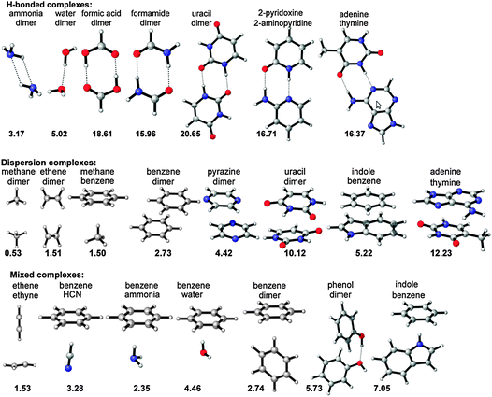
S22 dataset of intermolecular interactions

Slide 5
S22: performance of popular methods
MAD, kcal/mol
 | HB | disp | mixed | overall
HF | 3.29 | 7.24 | 3.15 | 4.56
B3LYP | 1.77 | 6.22 | 2.64 | 3.54
PBE | 1.13 | 4.53 | 1.66 | 2.44
M06 | 0.89 | 0.99 | 0.67 | 0.85
M06-2X | 0.73 | 0.36 | 0.32 | 0.47
ωB97X-D | 0.27 | 0.30 | 0.42 | 0.33
MP2 | 0.24 | 1.69 | 0.61 | 0.88
SCS-MP2 | 1.54 | 0.55 | 0.37 | 0.80
SCS-CCSD | 0.40 | 0.23 | 0.08 | 0.24
Amber | 4.64 | 0.98 | 0.89 | 2.12
OPLSAA | 4.45 | 1.07 | 0.56 | 1.98
MMFF94 | 3.61 | 0.73 | 0.60 | 1.61
EFP | 1.82 | 0.57 | 0.35 | 0.89
10% error | 1.38 | 0.48 | 0.39 | 0.74
J. Chem Theory Comp., 8 (8), 2835–2843 (2012)

Slide 6


S22: performance of force fields
Paton et al, J. Chem. Inf. Model. 2009, 49, 944–955
Dr. Dmytro Kosenkov
Joanna Flick

Slide 7
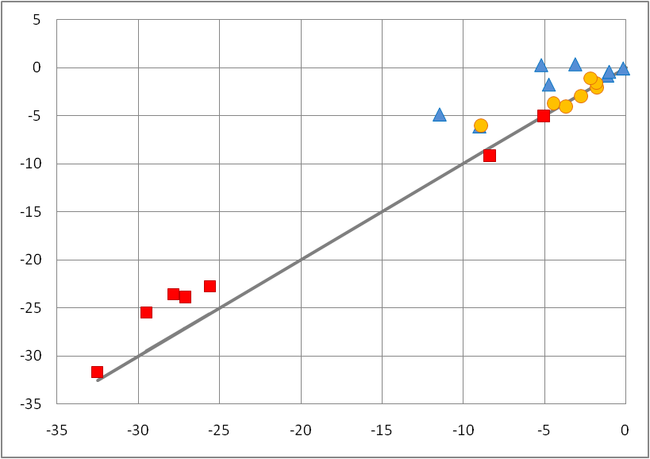
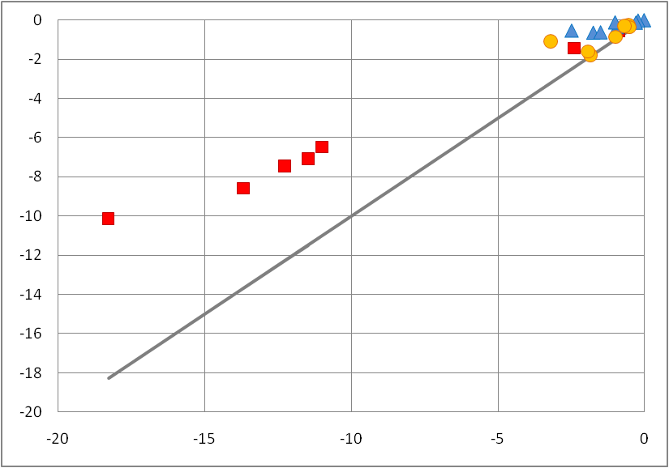
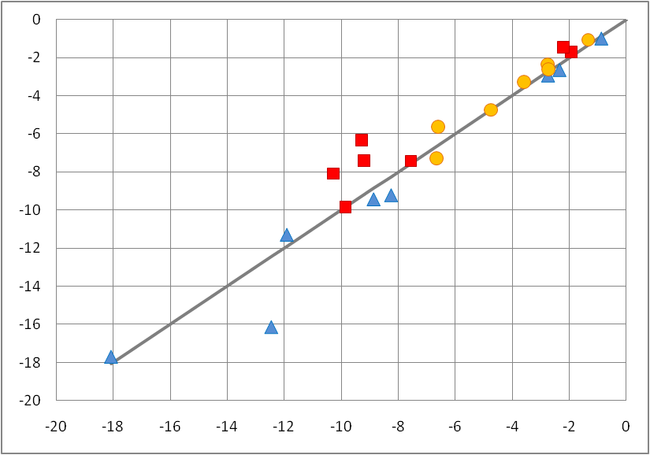
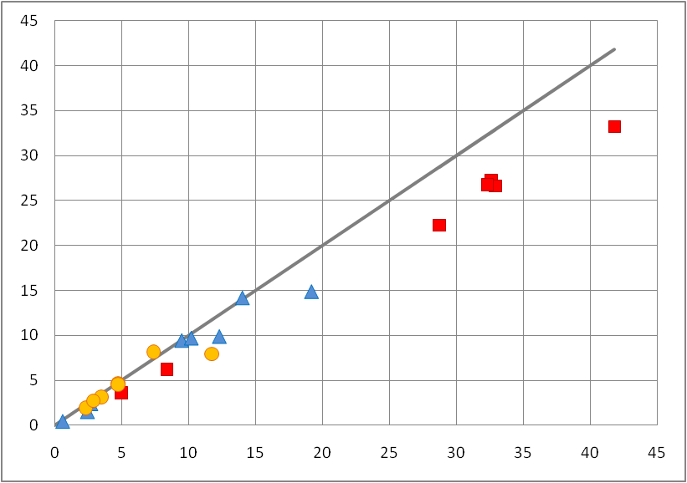
EFP vs SAPT
electrostatic
induction
charge-penetration
energy
charge-penetration & missing charge-transfer
dispersion
exchange-repulsion
good!
H-bonded
dispersion-dominated
missing correlation
mixed
J. Chem Theory Comp., 8 (8), 2835–2843 (2012)

Slide 8
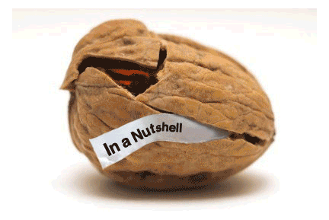
EFP in a nutshell
rigid-geometry fragment-based polarizable force field
all EFP force field parameters are obtained from a separate ab initio calculation: no fitted parameters
provides physical insight into intermolecular interaction
accuracy: 10-15% relative error in interaction energies (similar to MP2, better than many DFT functionals, superior to classical force fields)
accuracy can be further improved
Notes:
11

Slide 9
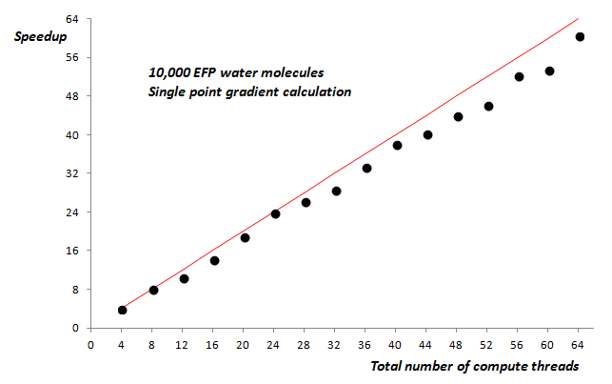
LibEFP: stand-alone EFP implementation
written in standard C99
uses native EFP data format generated by GAMESS
2-clause BSD license
uses BLAS wherever possible for better performance
available as a shared or static library
parallelization across multiple nodes using hybrid MPI/OpenMP
Dr. Ilya Kaliman
http://www.libefp.org/
Kaliman and Slipchenko, JCC 34, 2284 (2013)
Kaliman and Slipchenko, JCC 36, 129 (2015)

Slide 10
LibEFP
LIBEFP
EFP-only
system
various QM/EFP methods
Q-Chem
EFPMD
PSI4
distributed with LIBEFP code
molecular dynamics in NVE, NVT, and NPT ensembles
NWChem
Gamess
Tinker
MM/EFP schemes
free energy calculations with EFP
Molcas
Gromacs

Slide 11
QM-LibEFP interface

Slide 12




iSpiEFP: GUI and job manager
molecular structure
computational resource
xyz, pdb, cif
data formats
high-performance server
cloud computing
iSpiEFP
molecular visualization /animation / editor tool
job workflow editor / manager / scheduler
Java applet with integrated Jmol molecular viewer / editor
EFPdb
MySQL database with fragment parameters
local machine
Notes:
General scheme of GUI here

Slide 13
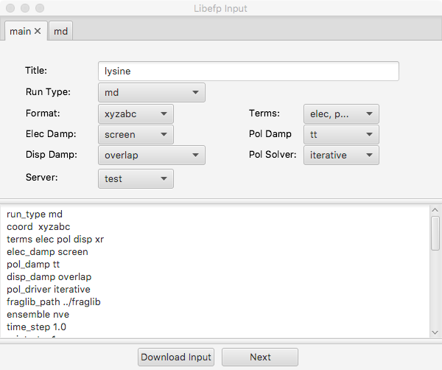

iSpiEFP: EFP workflow
molecular structure
visualization
automatic
proteins, DNA, fatty acids
fragmentation
manual
user-defined fragmentation
smart substructure search
visualization of fragmented system
search locally
preparing fragment parameters
search EFPdb database
compute parameters
prepare MAKEFP GAMESS input
submit GAMESS job
( remove capping points )
prepare EFP input
submit job to computational resource
visualization, animation, analysis

Slide 14

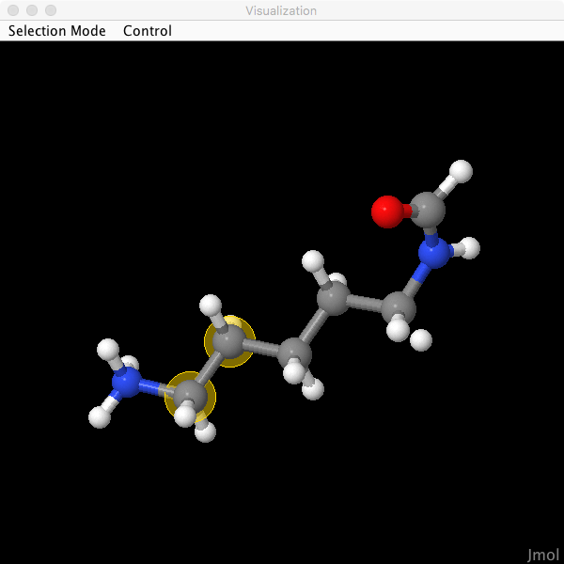
Fragmentation of covalent systems
automatic
proteins, DNA, fatty acids
manual
user-defined fragmentation
smart substructure search

Slide 15
Fragmentation of covalent systems
automatic
proteins, DNA, fatty acids
manual
user-defined fragmentation
smart substructure search
O
||
O
||
−C_{a}H−C−NH−C_{a}H− −C−NH−C_{a}H−
|
R
|
R
|
R
O
||
O
||
cap with H
−C_{a}H−C−NH−C_{a}H−H
H−C−NH−C_{a}H−
|
R
|
R
compute EFP parameters
|
R
automated
O
||
remove caps
O
||
−C_{a}H−C−NH−C_{a}H
redistribute residual charge
C−NH−C_{a}H−
|
R
|
R
|
R

Slide 16




EFPdb parameter database
official parameters
official parameters
open to the world
EFPdb
user group parameters
MySQL database with fragment parameters
user group parameters
user group parameters
open to users within the group
Fragment info
name
chemical formula
smile string
EFP terms
basis set used
status (official / unofficial)
structure (xyz format)
parameters for each term
user group parameters
* group is defined during GUI registration

Slide 17
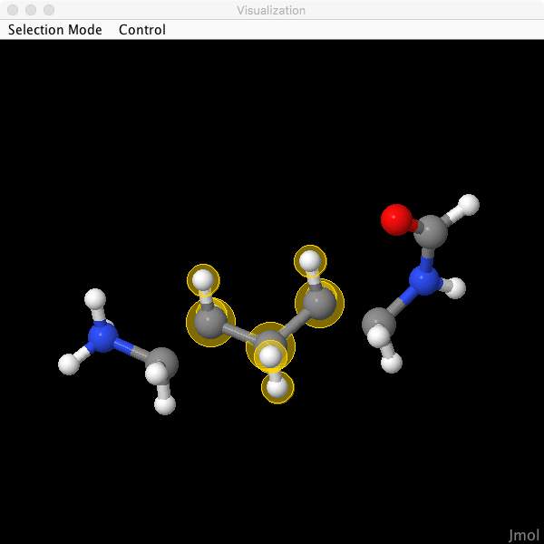
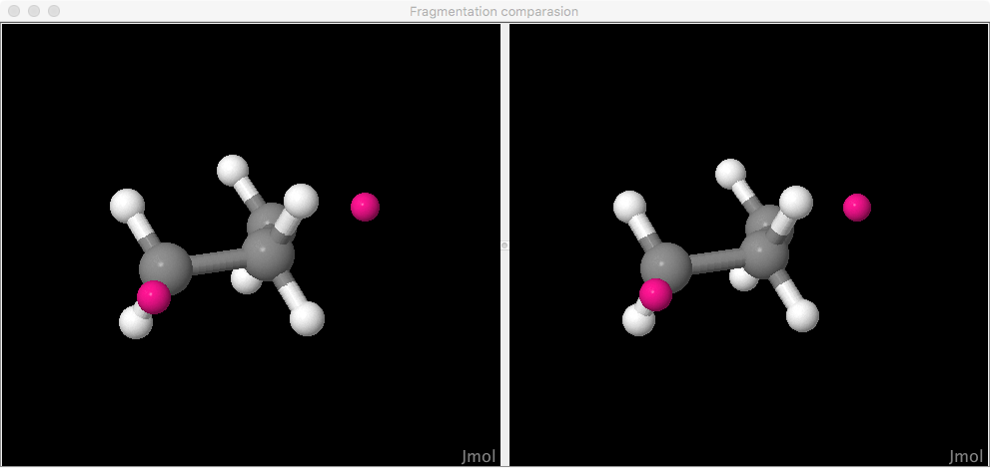
Fragment search
search local directories
search EFPdb database
Search is based on:
Chemical formula (ordered)
Connectivity map (distinguishing between structural isomers)
RMSD between atom positions
a list of fragments with user-defined tolerance on RMSD
visualization of all fragments in the list
selection of a fragment default: smallest RMSD

Slide 18
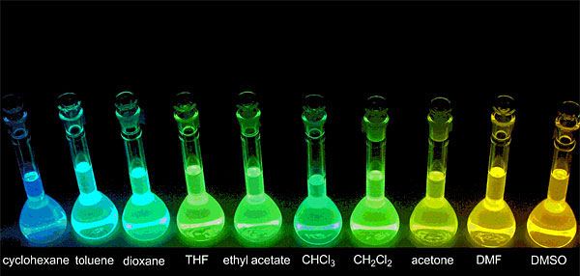
Solute-solvent tete-a-tete
Solvatochromism = differential solvation of the ground and excited states of a chromophore
Influence of solvent on properties of solute

Slide 19

QM / EFP
EFP
solute
solvent
EFP
QM
E_{int}
EFP
coupling term
E_{int}
EFP
EFP
electrostatic embedding
full embedding
polarizable embedding
Notes:
Add more refs

Slide 20
Self-consistent polarization
QM region
EFP region
static multipoles
Ψ
nuclei
induced dipoles
total field
Induced dipole
polarizability tensors
F^{total} = Σ (F^{mult} + F^{ind}) + F^{ai} + F^{ai-nuc}
E^{pol} = -½ Σ μ (F^{mult} + F^{ai-nuc}) + ½ Σ μ F^{ai}

Slide 21
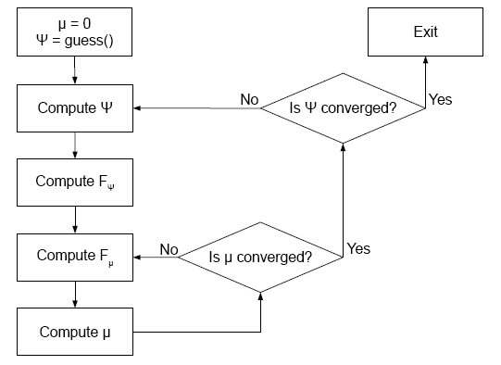
Polarization within HF cycle
HF
self-consistent cycle
polarization
self-consistent cycle

Slide 22
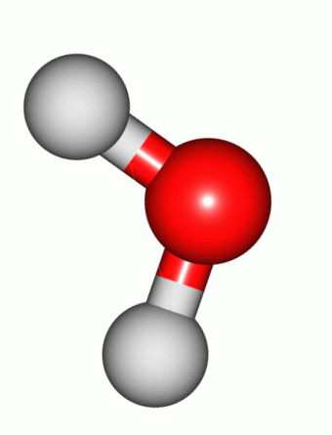
QM/EFP for the electronic excited states
Generally, each excited state has different electron density & charge distribution
different response from environment state-specific perturbative treatment
Polarization correction to the excitation energy due to polarizable environment (using one-electron excited state density):
ΔE^{pol} = E^{pol,ai}(μ^{ex}) – E^{pol,gr}(μgr) - Σ (μ^{ex} – μgr)F^{ai,ex}
leading correction to the interaction between μ^{ex} and Ψ ^{ex}
Thompson & Schenter, JPC 99, 6374 (1995)

Slide 23
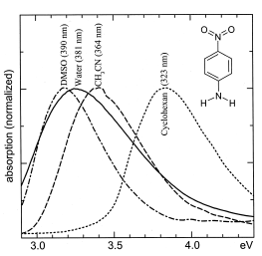
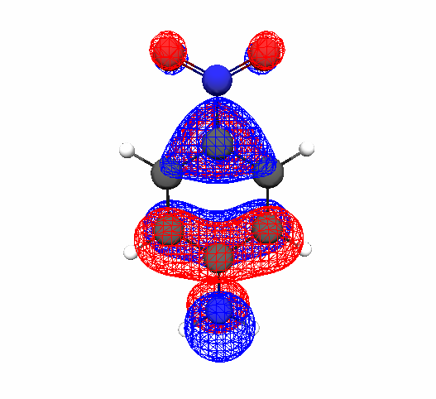
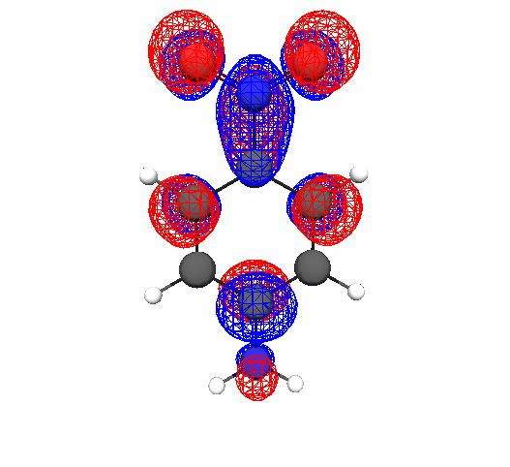
Solvatochromism in para-nitroaniline
Para-nitroaniline (pNA) – a chromophore with bright low-lying charge-transfer state
absorption spectrum
-
charge-transfer π->π* transition
+
μgr = 6.2 D
μ^{ex} = 15.3 D
Kovalenko, Schanz, Farztdinov, Hennig, Ernsting, CPL 323, 312 (2000)

Slide 24

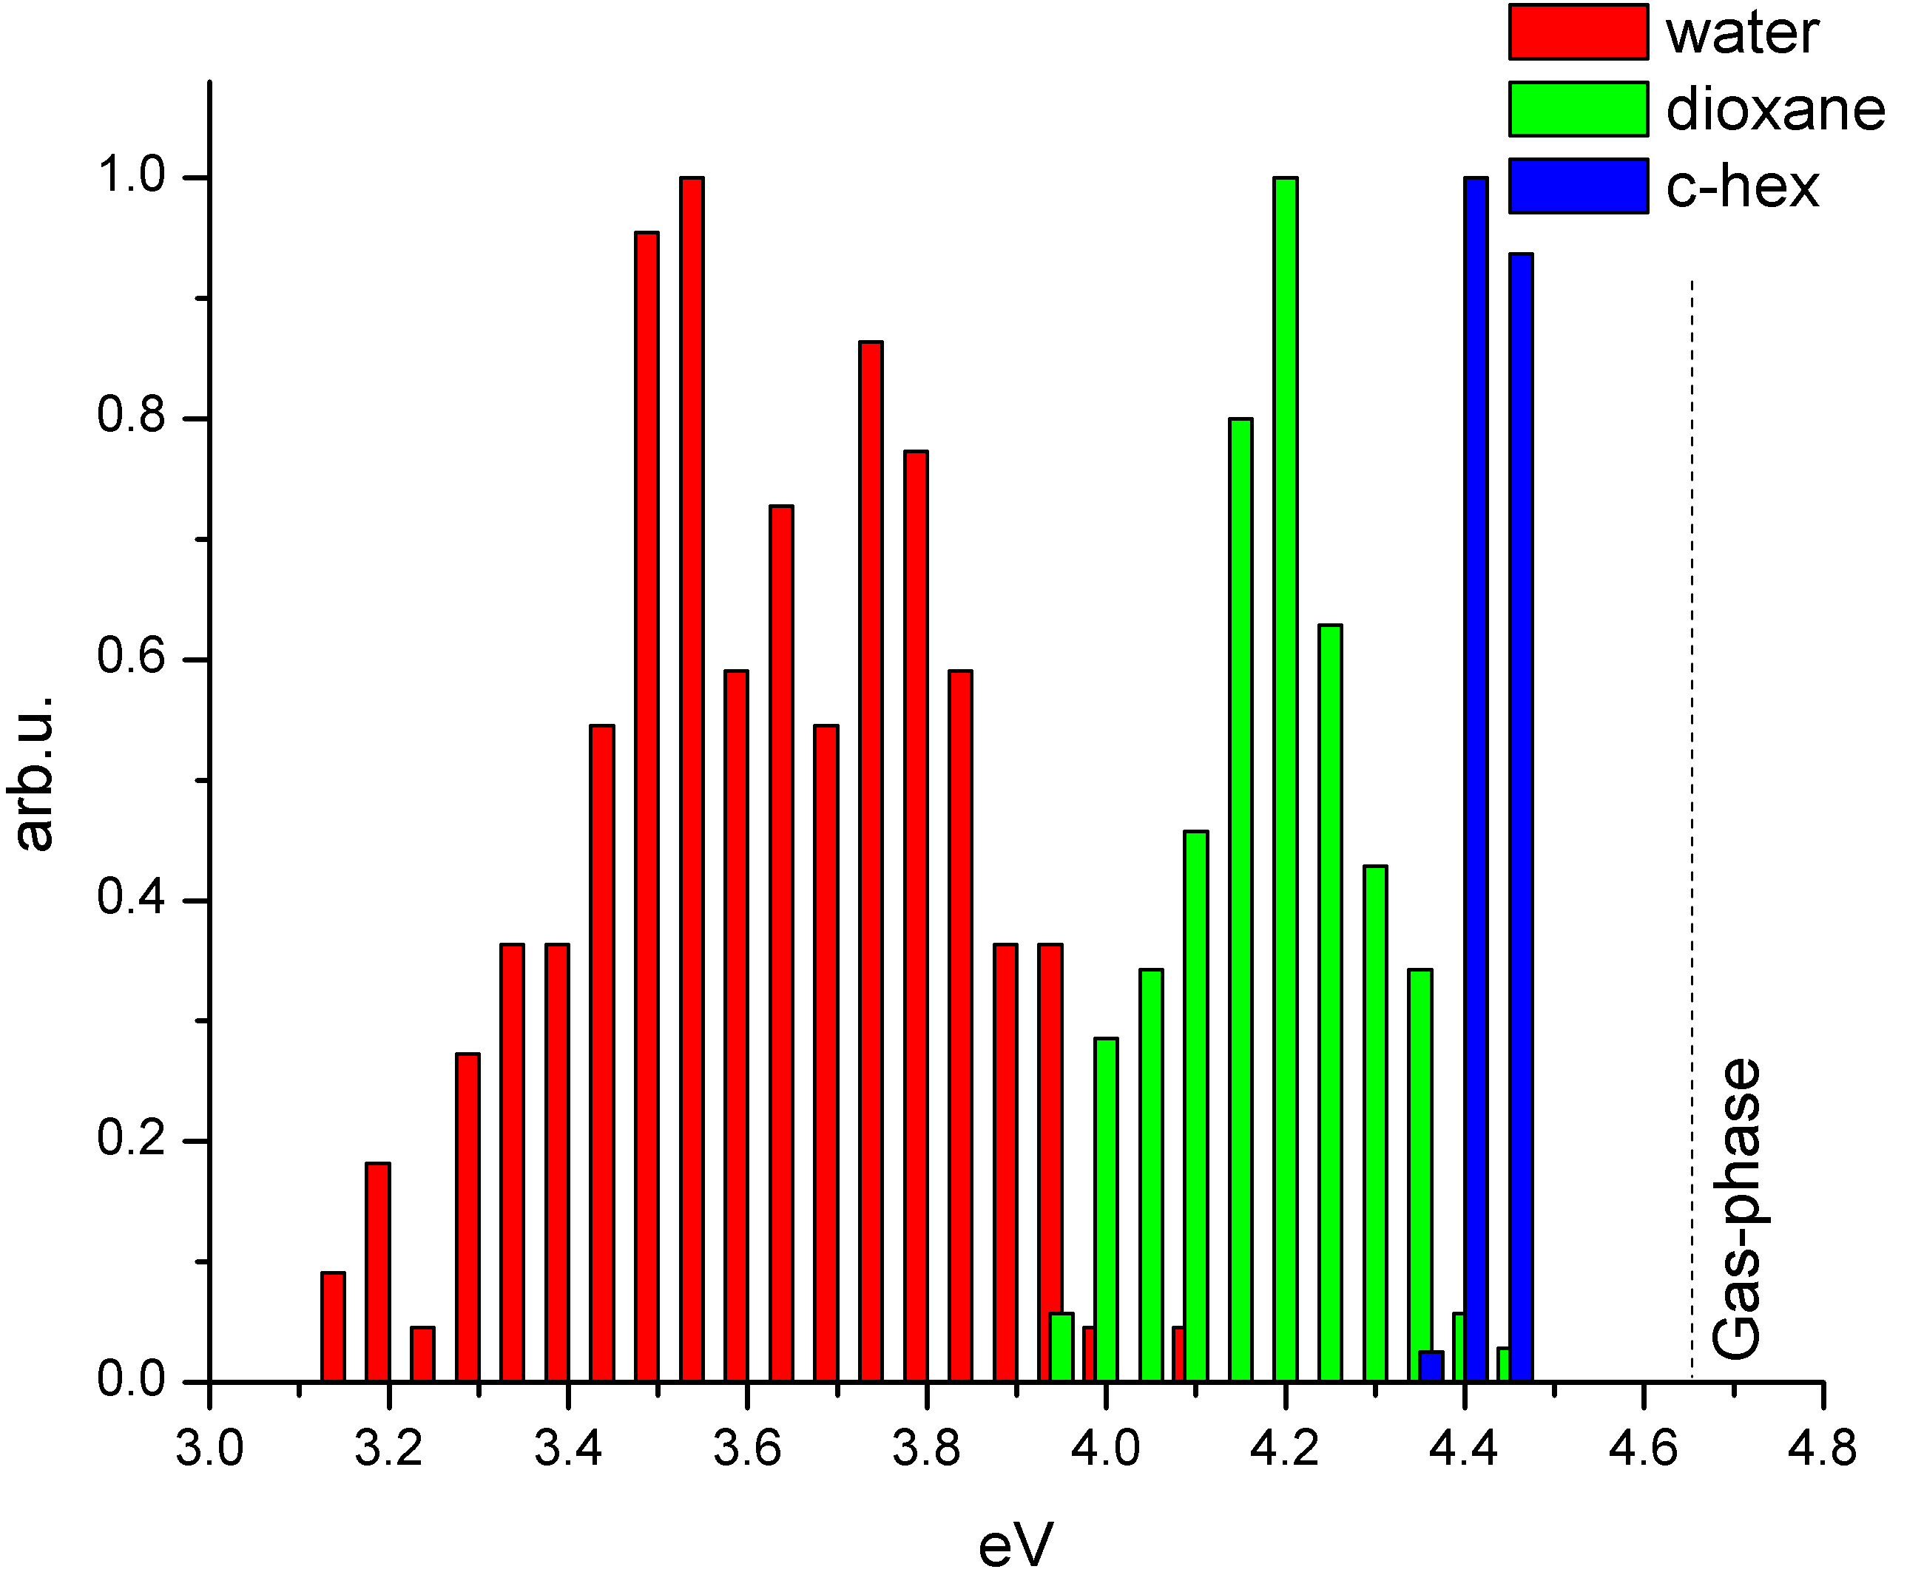
Solvatochromic shifts in pNA
water
1.02 eV
expt: 1.0 eV
gas phase
Dr. Dmytro Kosenkov
dioxane
0.44 eV
expt: 0.72 eV
c-hexane
0.20 eV
expt: 0.41 eV
Kosenkov & Slipchenko, JPCA, 115, 392 (2011);
Kovalenko et al, CPL 323 (2000) 312;
Morgan et al, JCP 115 (2001) 912

Slide 25

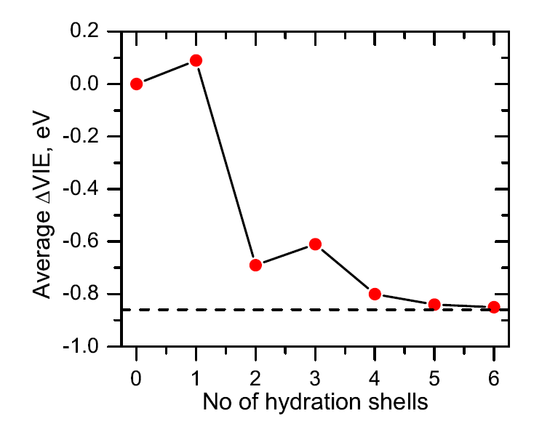
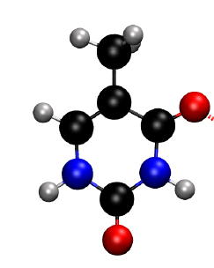
Vertical ionization energy of hydrated thymine
due to microhydrates!
Dr. Debashree Ghosh
electron acceptor,
increases VIE
EOM-IP-CCSD/EFP
electron donor,
decreases VIE
Ghosh, Isayev, Slipchenko, Krylov,
JPCA 115, 6028 (2011)
Notes:
When the water molecule is
h-bonded to the NH groups of thymine, it acts as the electron donor
and, therefore, reduces the VIE. Likewise, water that is hydrogen-
bonded to the carbonyl groups acts as the electron acceptor, thereby
increasing the VIE.

Slide 26
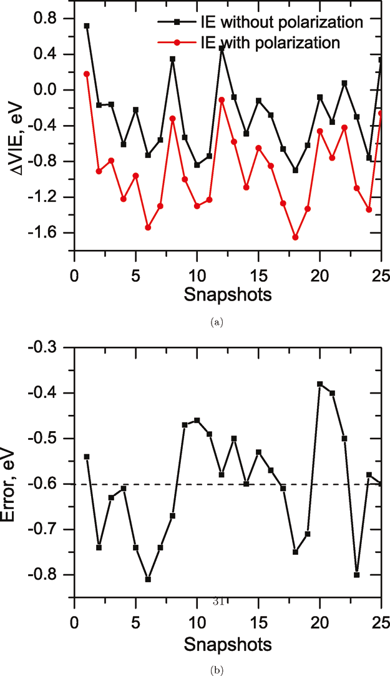
VIE of hydrated thymine
Polarization of environment is extremely important!

Slide 27
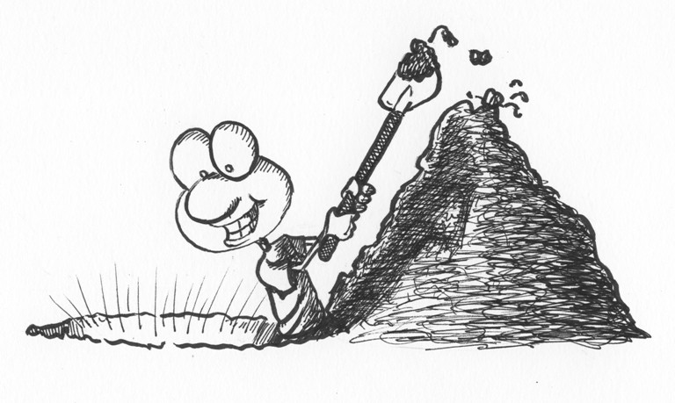
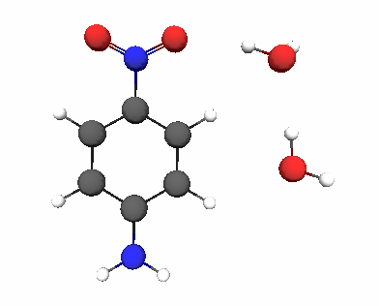
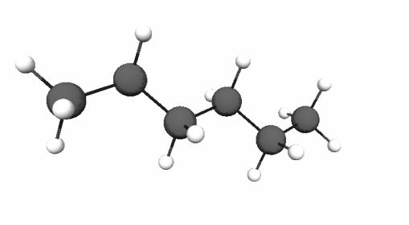
A closer look at solvatochromism
Electrostatic terms (dominant in polar or polarizable solvents) -
stabilize the electronic state with larger partial charges, with larger dipole moment
Short-range “cavity terms” (dominant in non-polar solvents)
stabilize the electronic state of “smaller” size
QM/EFP
electrostatic,
polarization
dispersion, exchange-repulsion
+
+
+
-
-
+
+
-
+
+
-
+
+
-
+
-
-
+
+

Slide 28
QM / EFP: toward full embedding
EFP
solute
solvent
EFP
QM
E_{int}
EFP
E_{int}
EFP
EFP
coupling term
Smith, Ruedenberg, Gordon, Slipchenko, JCP 136, 244107 (2012);
Slipchenko, Ruedenberg, Gordon,
JPCA 2017, 121, 9495−9507
Notes:
Add more refs

Slide 29
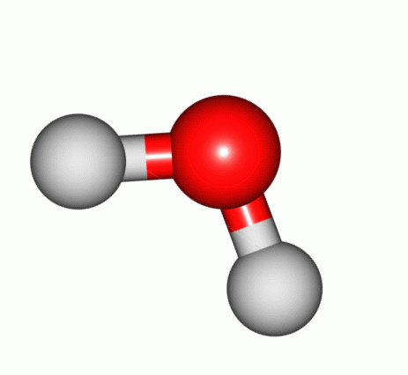
Long-range perturbation theory
ρ_{A}
ρ_{B}
electrostatic energy
polarization (induction)
energy
dispersion energy

Slide 30
Dispersion energy between EFP fragments
Applying multipole expansion to classical fragments A and B, the perturbation H’ becomes:
T, Tα and Tαβ are the electrostatic tensors of zero, first, and second rank
The leading term (C6):
Introducing Casimir-Polder identity:
and notations for
dynamic polarizability tensor:
Principal
fragment-fragment
energy

Slide 31
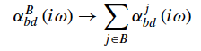
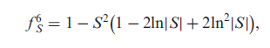
Approximations in EFP-EFP dispersion term
Distributed polarizabilities (on LMOs):
Isotropic and spherical-atom approximation for polarizabilities:
EFP-EFP C6 coefficient computed using 12-point quadrature:
Damping function using inter-fragment overlap integrals:
4/3 factor to account for higher-order terms
Amos et al, J. Phys. Chem. 1985, 89, 2186-2192;
Adamovic & Gordon, Mol. Phys. 2005, 103, 379-387;
Slipchenko and Gordon, Mol. Phys., 107, 999 (2009)

Slide 32
QM-EFP dispersion
Applying multipole expansion to classical fragment B, while A remains quantum, the perturbation H’ is:
Again, using Casimir-Polder identity and gathering terms for dynamic polarizability tensor on fragment B:
Approximating the sum-over-state expression by the orbital-based summation, obtain the principal expression:

Slide 33
QM-EFP dispersion
electric field integrals in occupied-virtual block
(“transition” electric field)
computed using
12-point quadrature
Distributed polarizability tensors (on fragments) are used
Information from the QM subsystem: electric field integrals, orbital energies
Additive correction to SCF energy of the QM-EFP system
Slipchenko, Ruedenberg, Gordon,
JPCA 2017, 121, 9495−9507

Slide 34
Simple tests
Dispersion energy, kcal/mol
R-R₀, Angstrom

Slide 35
Favorite test: benzene dimer
Dispersion energy, kcal/mol
R_{COM}, Angstrom

Slide 36
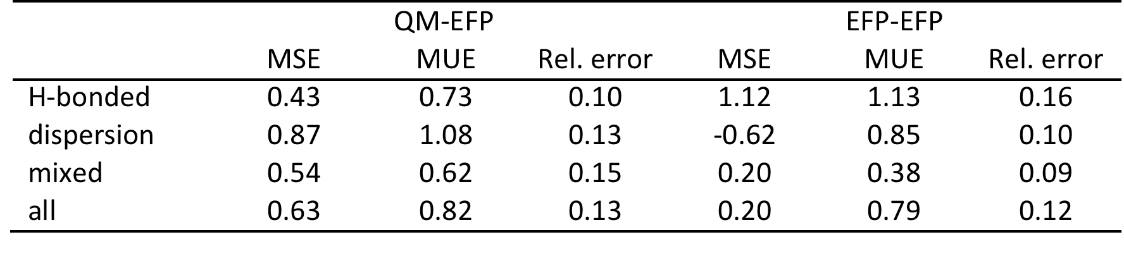
Benchmarking on S22 dataset
values in kcal/mol
QM-EFP and EFP-EFP dispersion terms perform similarly

Slide 37
Practical aspects of using QM/EFP dispersion
Dependence on QM basis set
Dispersion energy, kcal/mol
6-31G*
CCD
6-31+G*
ACCD
6-311G*
6-311+G*
6-311++G**
CCT
6-311++G(3df,2p)
ACCT
6-31G*
CCD
6-31+G*
ACCD
6-311G*
6-311+G*
6-311++G**
CCT
6-311++G(3df,2p)
ACCT

Slide 38
Practical aspects of using QM/EFP dispersion
Dependence on DFT functional
Dispersion energy, kcal/mol
HF
PBE0
BLYP
B3LYP
HF
PBE0
BLYP
B3LYP

Slide 39
Dispersion for the ground electronic state
occ
vir
occ
vir

Slide 40
Dispersion for the excited electronic state
Suppose CIS formalism:
occ
a
vir
i
occ
i
a
vir

Slide 41
Dispersion for the excited electronic state
Suppose CIS formalism:
occ
a
vir
i
occ
vir

Slide 42
Dispersion for the excited electronic state
Suppose CIS formalism:
occ
a
vir
i
occ
i
a
vir

Slide 43
Dispersion for the excited electronic state

Slide 44
Does it work?
Dispersion energies, kcal/mol
 | Ground state | Triplet state
 |  | HF | CIS
Water dimer | -1.72 | -2.94 | -3.47
Ammonia dimer | -1.73 | -3.58 | -2.95
Ethene dimer | -2.03 | -2.07 | -1.89

Slide 45
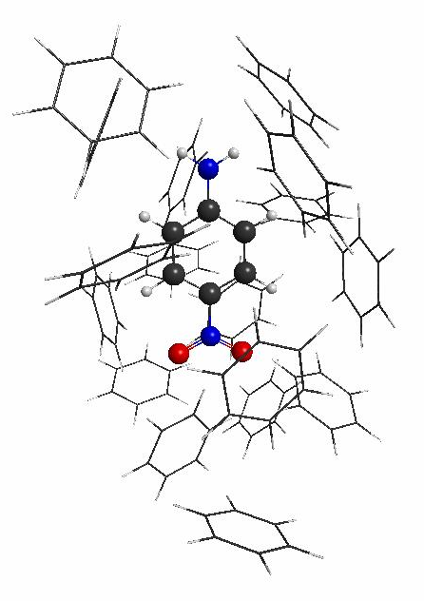
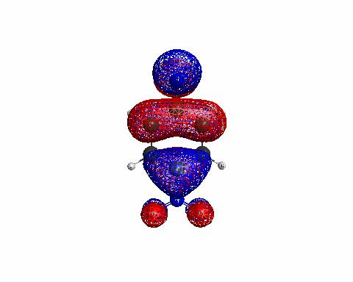
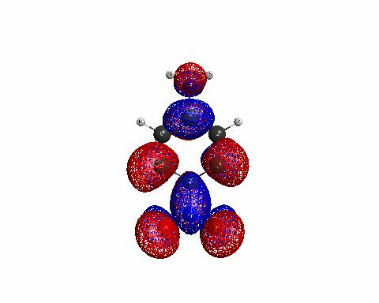
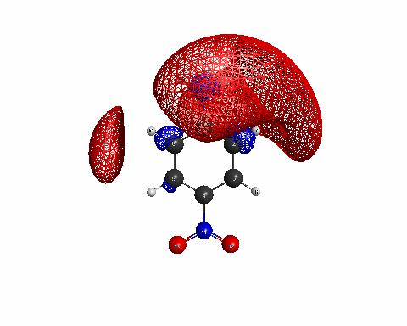
Solvatochromism in pNA: revisited
QM/EFP: polarizable embedding + dispersion
QM/EFP dispersion in the ground state: -1.26 eV
eV | Excitation energy | Dispersion correction | Total energy
S₂ | 5.26 | -0.29 | 4.97
S₅ | 6.16 | -1.65 | 4.51
π→π*
π→Ryd
pNA in small benzene cluster
Repulsion between QM and EFP regions
is a MUST!
CIS/6-31+G* //EFP

Slide 46
QM / EFP: toward full embedding
EFP
solute
solvent
EFP
QM
E_{int}
EFP
E_{int}
EFP
EFP
coupling term
Annu. Rev. Phys. Chem., 64, 553-78 (2013);
Viquez-Rojas and Slipchenko, in prep
Notes:
Add more refs

Slide 47

QM-EFP exchange-repulsion
3-center-1-electron integrals are computed
Need a pair of parameters for each unique LMO
Parameterization is done based on comparison to SAPT0 ex-rep and total energies and EFP ex-rep energies for molecular clusters extracted from high-temperature MD trajectories
Exchange-repulsion in QM/EFP1 (EFP1: water potential) is done similarly
Claudia Viquez-Rojas
Viquez-Rojas, Fine, Slipchenko, submitted to JCP

Slide 48
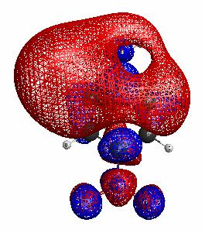
Solvatochromism in pNA: revisited 2
Full-embedded QM/EFP
QM/EFP dispersion in the ground state: -1.22 eV
eV | Excitation energy | Dispersion correction | Total energy
S₂ | 5.35 | -0.21 | 5.14
S₈ | 7.97 | -0.51 | 7.46
π→π*
π→Ryd
pNA in small benzene cluster
Full-embedded QM/EFP provides qualitatively correct description of Rydberg states
CIS/6-31+G* //EFP

Slide 49
Full QM/EFP energies for S22 dataset
QM/EFP performs better than EFP!
Viquez-Rojas, Fine, Slipchenko, submitted to JCP

Slide 50
Conclusions
EFP is first-principles based polarizable force field
LIBEFP is a stand-alone EFP implementation designed for interfacing with ab initio and dynamics software
QM/EFP: full embedding scheme for describing electronic structure in heterogeneous environments
Excited state dynamics?
Missing analytic gradients: state-specific polarization and excited state dispersion contribution. Can they be ignored?
Need QM dynamics driver. Limited possibilities exist in GAMESS, Q-Chem,… We are interested in collaborations!

Slide 51
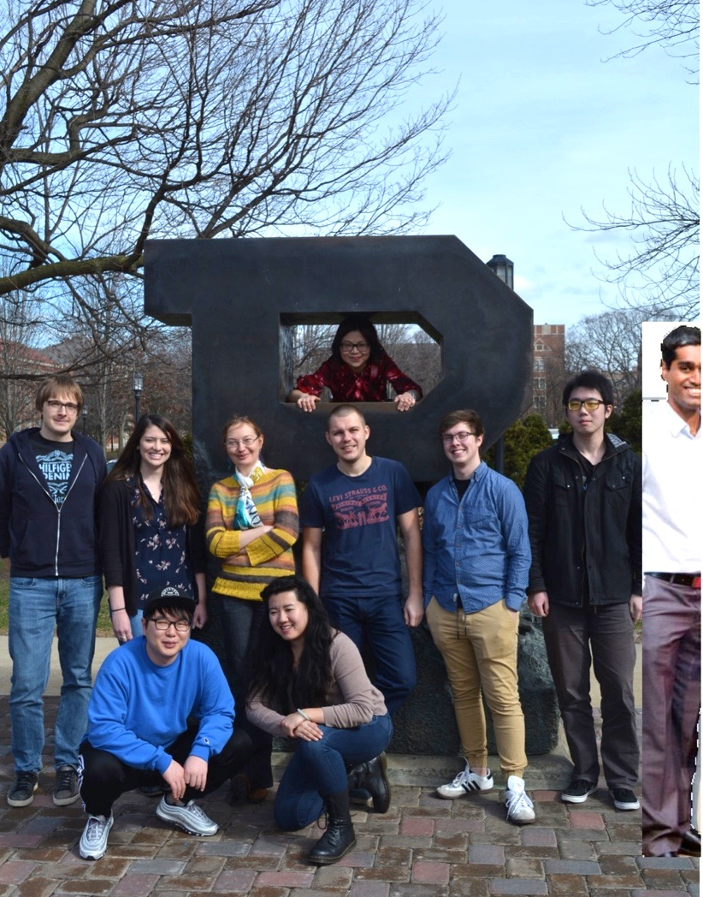

Acknowledgements
Group members:
Dr. Danil Kaliakin
Pradeep Gurunathan
Yen Bui
Yongbin Kim
Claudia Viquez Rojas
Nikita Dubinets
Hanjjing Xu
Jia Lin Cheoh
Ryan DeRue
Group alumni:
Dr. Carlos Borca
Dr. Ilya Kaliman
Dr. Dmytro Kosenkov
Dr. Ben Nebgen
Dr. Mandy Green
Dr. Mike Hands
Dr. Frank Emmert
…
$$$:
NSF CTMC
NSF SI2-SSI
NSF AIR:TT

